Slide 1
Festival Taps
Kenan Mehmet

Slide 2
Scoping out the specification
Require a function that will take two parameters, a list of integers and a integer to represent how many taps.
The value that needs to be returned is how many seconds it takes to fill up every water bottle
Will need to represent what taps are being used and for how long
Will need to convert the size of the bottles into seconds to be filled up.

Slide 3
Mapping out the algorithm
Have two arrays, the first array will be the total time a tap is spent filling up water bottles (taps), a second array to have how long is left on the tap needed to fill up the array (occupied_taps).
For each water bottle, find a free tap, add the time it takes to fill up the water bottle to the tap
Once eac tap is occupied, find the lowest time for these taps.
Add that time to all the taps, subtract that time to the occupied taps
Once there are no more bottle, add the reaminaing occupied time to their respective taps
Return the tap with the highest time.

Slide 4
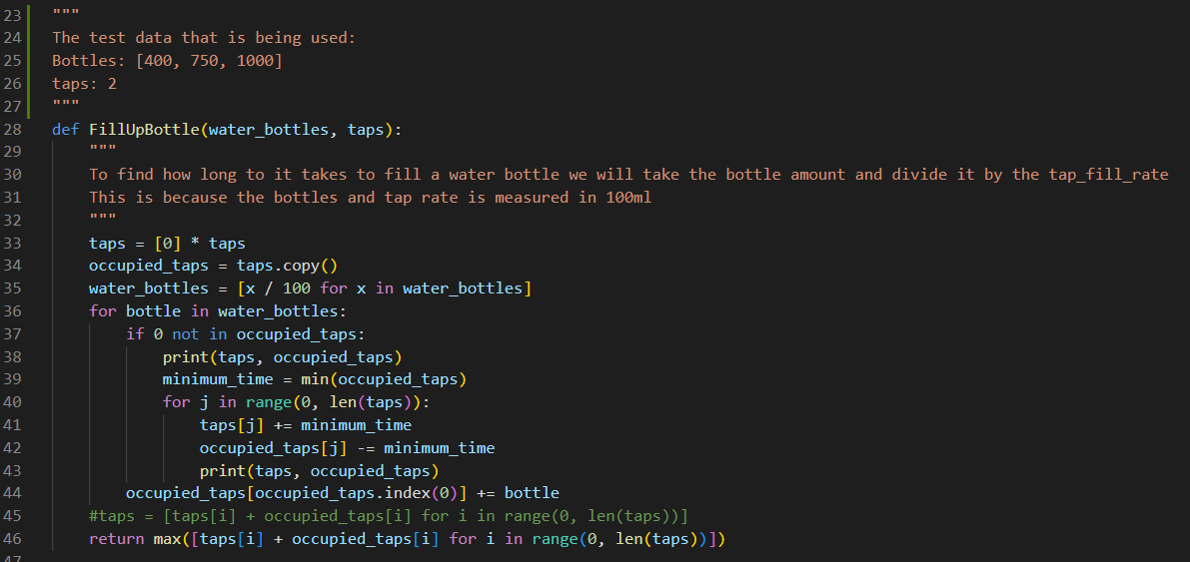
First Revision of function complete

Slide 5
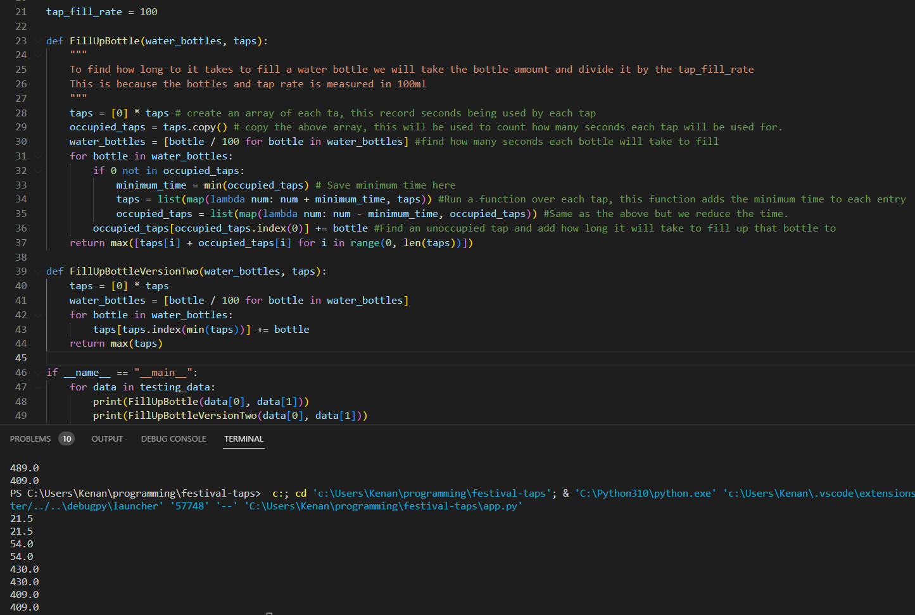
Improving on the function
I was able to come up with a more efficient version of my initial function based on looking at the test data.
I had found that we just need to add the time needed to fill up the bottle to each tap and then return the highest time at a tap.

Slide 6
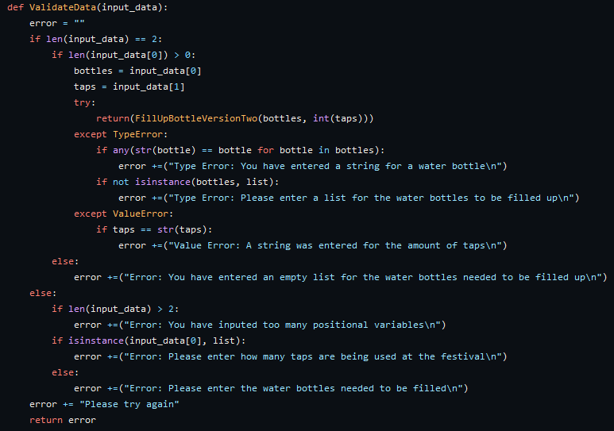
Bonus step 1: Validate Data
For validating data, I decided to map out possible ways that the function could error out. These included strings, float variables, empty input data.
From here I would find as much as these errors and then return that in an error string using a try statement.

Slide 7
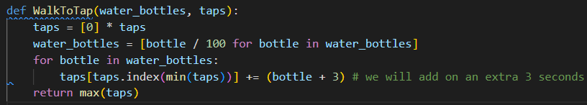
Bonus Step 2: Walk to the tap
For this step I added an extra 3 seconds onto each time it takes to fill up a water bottle

Slide 8

Bonus Step 3: Different Flow speeds
To figure out how to capture each flow speed with being used to fill the bottles we will now need to use a different equation
Previously we just divide the bottle millimeters by a static number of 100 and that would be how many seconds needed to fill the bottle
Now instead we need to divide the bottle length by our new rate, we will need to also store the tap rate to be used for each tap
I will now need to make a new way of dynamically creating the array of time used at each tap
This line would create this array [0,0,0,0] if the amount of taps was 4
Now Instead we will parse through a list like [50, 100, 250, 400] which represent each tap speed
This line will now be used and it will create the following array
In our array holds an array which includes the time spent at the tap and the speed of the tap.

Slide 9
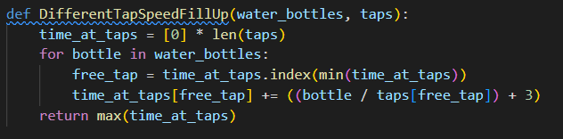
Bonus Step 3 code:

Slide 10
Bonus Step 4:
For bonus step 4, my main theory going into this step was that it is possible that there would be a longer overall time, if the slower tap had to fill up a very large bottle.
I then create a series of different data sets of bottles to test out
After testing these different data sets what I had found was that the initial time of two taps starting at the same speed of 100ml per second, will always be the slowest time.

Slide 11


However
It is possible for a faster tap to take longer but only if the taps started differently from each other
In this data set, the faster tap does cause a slower overtime, because the last very large bottle is now being filled by the slower tap instead of the longer tap, and this slowest time stayed this until the faster tap was at speeds of 330ml

Slide 12
What I would have done with more time
Convert the code into Javascript
Create a front end website
Find a way to reduce the lines either further in my functions
Test out more data for Bonus step 5

